Slide 1

OCR AS/A Level Computer Science (H446) Project NEA CPD for Internal Moderation

Slide 2
Aims/Objectives
Give brief guidance on the effective internal moderation of the specification (H446) project
Consider ideas and approaches for the teaching and assessment of the coded programming project (NEA)

Slide 3
Structure
H446/03 (04)

Slide 4
The A-level Units
Two exams, externally assessed
01 Computer Systems (2 hours 30 mins) 40% of A-level
02 Algorithms and programming (2 hours 30 mins) 40% of A-level
One Programming project (NEA), internally assessed, externally moderated
03/04 (04 = re-take) 20% of A-level

Slide 5
H446/01
2 hour 30 minute exam
140 marks
Short and long answer
Candidates may be required to write algorithms

Slide 6
H446/01
Components of a computer
Structure and function of the processor
Types of processor
Input, output and storage
Types of software and different methodologies used to develop software
Systems software
Applications generation
Software development
Types of programming language

Slide 7
H446/01
Exchanging data
Compression, encryption and hashing
Databases
Networks
Web Technologies

Slide 8
H446/01
Data types, data structures and algorithms
Data types
Data structures
Boolean algebra
Legal, moral, cultural and ethical issues
Computing related legislation
Moral and ethical issues

Slide 9
H446/02
2 hour 30 minute exam
140 marks
Section A
Short and long answer questions
Section B
Questions based around one scenario
Candidates will need to write pseudocode/program code
Notes:
Candidates are not expected to write in the same syntax as the OCR Pseudocode guide – this is what the exams will be written on and is intended to ensure nothing unexpected appears in the code they are given.

Slide 10
H446/02
Elements of computational thinking
Thinking abstractly: taking problem out of scenario
Thinking ahead: identifying issues and planning
Thinking procedurally: working through the problem
Thinking logically: efficient / logical solutions
Thinking concurrently: tackling problems at the same time
Problem solving and programming
Programming techniques
Computational methods
Algorithms
Notes:
Link is for A Level Specification that you may like to share with delegates. For Webinar it will be just on screen and you will talk about it whereas face to face you have more opportunity to even discuss the content.

Slide 11

H446/03
Programming project - NEA
Follow agile development
E.g. design and prototypes may be throughout the project, not just in one specific section
Internally assessed
Externally moderated
Produce and submit a report

Slide 12

The project
Does not need a specific end user Be careful here as you will need substantial stakeholder participation and feedback evidence – see moderator comments
Must be non-trivial, substantial coded element
Complex games (e.g. play against the computer)
Simulations
Timetabling/scheduling (automated)
Online multi-user website e.g. VLE/VML/social network
Trivial e.g.
Multiple choice quizzes
Accessing a database e.g. stock control
VBA projects

Slide 13
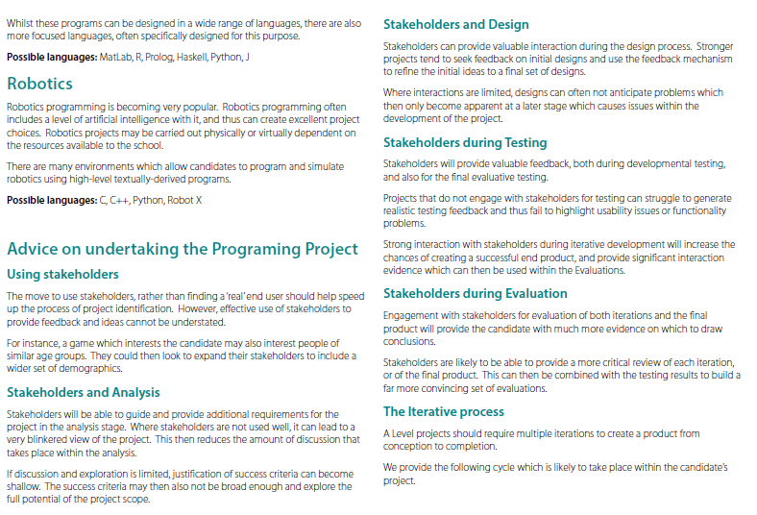

Slide 14
What languages can I use?
Must be appropriate – no drag and drop IDE development software applications
Acceptable languages:
Python
C family
Java
VB.NET (VBA is not usually sufficient) – try and steer clear
PHP
Delphi
E-mail computerscience@ocr.org.uk if the language you want to use is not here
Suitable GUI is required – command line accepted if part of machine code or assembly code level
Notes:
Ensure content matching

Slide 15
Other languages
In June 2017and 2018 exam series, we also allowed the use of:
Swift
JSON
NodeJS
Unreal/Unity (linked to C# etc.)
LUA
Robot X / Monkey X
JavaScript – expected to be used in conjunction HTML/CSS/MySQL/PHP
Notes:
Remind deletes that this list was for June 2017 exam series which may differ from June 2018 exam series.

Slide 16
What languages is ‘best’?
Totally dependent on:
The project
Candidate Skills
Level of familiarity
Programming Language Guide may help support choices
Most pupils likely to have studied Python at GCSE if they opted for OCR (~90% of centres)
There is no one ‘best’ language
You may submit projects in a range of languages – there is no need to stick to one programming language for all learners
Notes:
Page 7 – section 2 within programming language guide has suggested programming projects that students may be able to consider, if they are struggling with ideas of their own.

Slide 17
Programming Project Overview
Allows candidate flexibility in choice of project
Flexibility of language
Specified in Specification
Ask OCR if you want to use something different – get in writing
Now uses ‘Stakeholders’ rather than requirement for a ‘real’ 3rd party end user
Push to focus on the development and coding sides – this is the main body of the project
Focus on ‘project complexity’ – careful has been said this has been removed but suggest it remains for our Trust
Focus on RAD/Prototyping/Agile development
No need for a User Guide

Slide 18
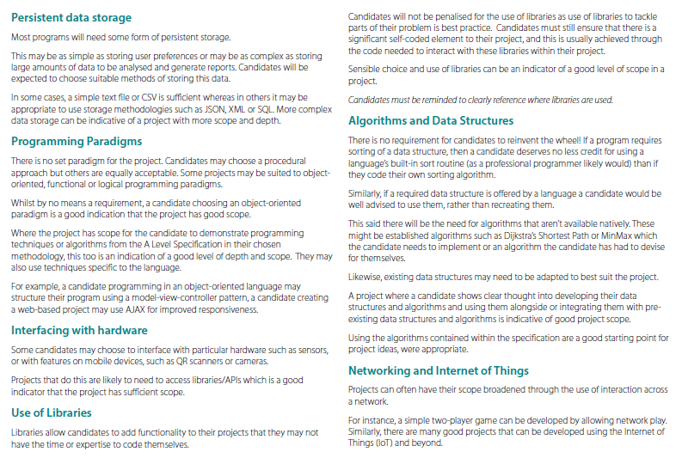

Slide 19
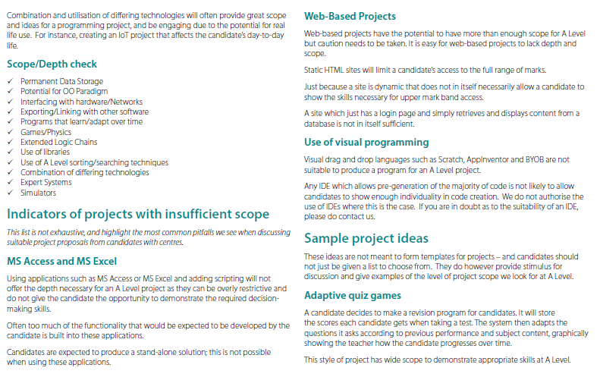

Slide 20


Slide 21

Preparation of Students
Ensure they are familiar with the ‘Process for Success’
Ensure they have learnt and understood all programming techniques/programming theory from Spec – evidence in their projects
Ensure they are familiar with how they will be marked/assessed
Ensure they pick a project they will engage with and be motivated to complete!
Better to pick a project with less depth that they can complete, rather than be over ambitious and get stuck
Can then develop project once working prototype exists
Notes:
Process for success diagram is in the second next slide from this so tell delegates that we will look at this in few minutes.
Programming techniques are listed within the specification
Marking criteria is within the spec and also teachers can download Unit Recording Sheet (URS) from the subject webpage.
Project guidance is given within A Level specification and within the ‘project complexity guide’ downloadable from the subject webpage

Slide 22
How do I start?
Ask students to write a short proposal about several projects
Include why they think it is a suitable project
Include what makes it complex – use check list
Discuss with them and decide which one
Notes:
Dot-Vote – where students put their vote on project ideas generated using a sticky notepad or paper as an activity showing their choice. Top 3 voted project is then taken further to students to consider.

Slide 23
Iterative Development Process Check
Success Criteria
Plan and Design
Development
Testing & Remedial Action
Evaluation
Success criteria
What will a successful solution do
Planning and design
Pseudocode, Flowcharts, DFDs, Class Definitions/UML etc.
Development
Narrative of steps taken
Annotated Code
Discussion of methodology
Testing and remedial actions
Narrative of changes made
Evaluation
Link to success criteria
Evidence of success or not
Notes:
Please remind delegates that Python style Pseudocoe is not a requirement for project planning and designing. A flowchart which is not detailed could be explained using a plain English in a logical order to show how their plan may work. There is a danger of students creating python code and then reverse engineering to show Python style Pseudocode.

Slide 24
Project Scope ACTIVITY
Likely significant Problems may look like/may include the following ideas – check sample projects against the following:
Permanent Data Storage
Potential for OO Paradigm
Interfacing with hardware
Exporting/Linking with other software
Programs that learn/adapt over time
Games/Physics
Extended Logic Chains
Use of libraries
Use of A Level sorting/searching techniques
Combination of differing technologies
Sharing of data of LAN/WAN
Expert Systems
Simulators
Notes:
Remind participant that ‘project complexity guide’ will be updated to reflect outcomes of the first exam series in June 2017. The document may be called different but no further details have been given by the Subject Advisors.

Slide 25
Any problems?
Please email OCR (computerscience@ocr.org.uk) if you are concerned about any of the following:
Scope
Project suitability
Approving Language Choice, if not on spec
GET IN WRITING

Slide 26
Assessing Programming Project (NEA)
Mark bands are best fit – NOT tick lists
Choose the band with the ‘best fit’ approach
If it meets all requirements in band (top)
If it meets most of the requirements in band (middle)
If it just meets the requirements (bottom)

Slide 27
Analysis
How is the problem solvable by computational methods
Why is a computer program needed?
E.g. requires calculations/accuracy
E.g. uses large amounts of data
E.g. needs 3D simulations that can be explored
Description of end user
their needs
how the system will meet their needs
Investigating existing (or similar) solutions
How do they work?
What components/features/approaches will be ‘borrowed’ and why?
Notes:
Inform delegates that we will looking at marking criteria for each part of the ‘process for success’ stating with Analysis
Go through points mentioned within the slide to have a quick discussion of teachers’ understanding

Slide 28
Analysis
Essential features
With justification
Limitations of proposed solution
E.g. what it may not be able to do
Hardware and software requirements
Measurable success criteria

Slide 29
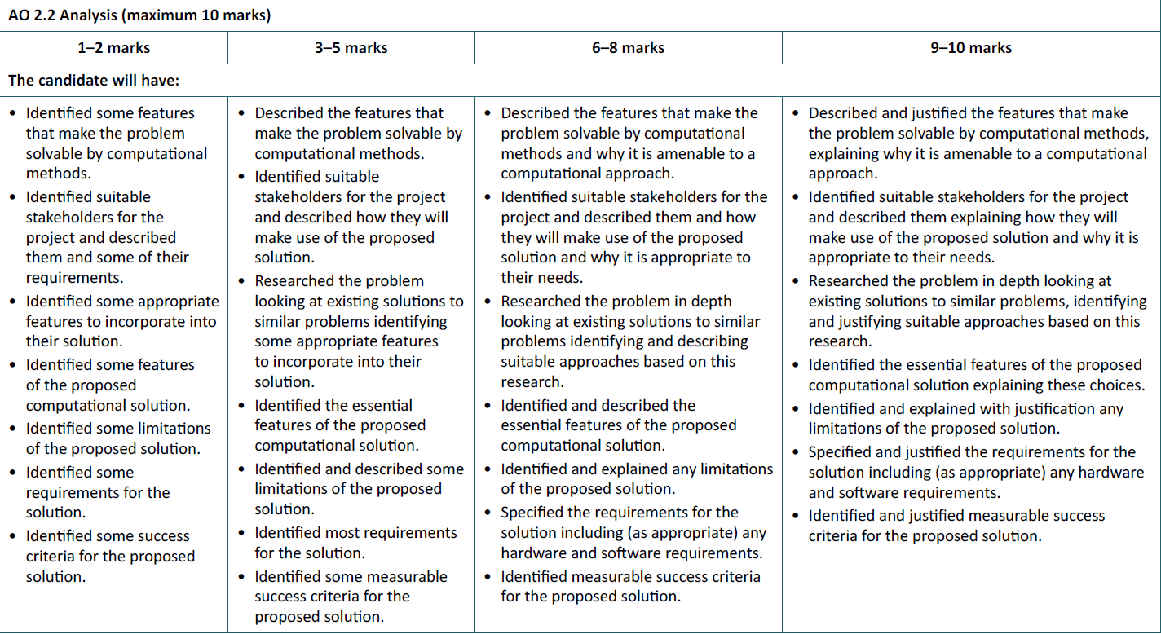
Analysis
Notes:
This marking criteria has been taken from A Level spec
Remind delegates when marking using ‘best fit’ approach, it is advisable to start highlighting bullet points from the highest mark band and then move towards lower mark band as this will allow them to justify their mark.
May be you could share some of your personal experience here

Slide 30
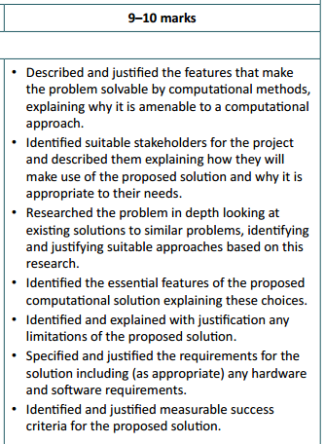
Analysis
Candidates will need to discuss why their project will be solvable using computational methods
Clearly identify their stakeholders, and the roles they will play
Show evidence of looking at other systems/ideas
Link this research into their proposed designs
Focus on key features (e.g. GUI Layout, Data structures) and explain why they have chosen these
Clearly delimit their problem and identify where they feel their project may face issues/limitations, discussing why these exist and the potential impact on the project
Generate an overarching set of requirements for the project and also identify hardware/software requirements where needed:
This may link to Software Versions (e.g. Only working on certain releases of web browsers due to functionality requirements)
Hardware requirements – mostly focusing on unique hardware issues where presents. Generic discussion of a minimal set of requirements for a PC is not needed. Would include
Define a clear set of Success Criteria that is a summary of the above and where each one is justified in relation to the Stakeholders /research etc. Include functionality and usability
Notes:
This slide shows the evidence required for the highest mark band criteria
Go through some bullet points on the right side of the slide
Similar activities/discussion could be taken for other slides as you move forward with your presentation

Slide 31
Design
Decomposition (e.g. structure diagram)
Algorithms (flowcharts/pseudocode) more focus on pesudo code than process flow
Explain how these form the solution (e.g. link to structure diagram)
Usability features
Describe key structures to be used (e.g. comment pseudocode/annotate flowcharts)
Variables
Data structures
Classes UML Class diagrams
Test data
Does not need to be full testing tables – just main data structures & algorithms linked to specification testing tables and user interfaces

Slide 32
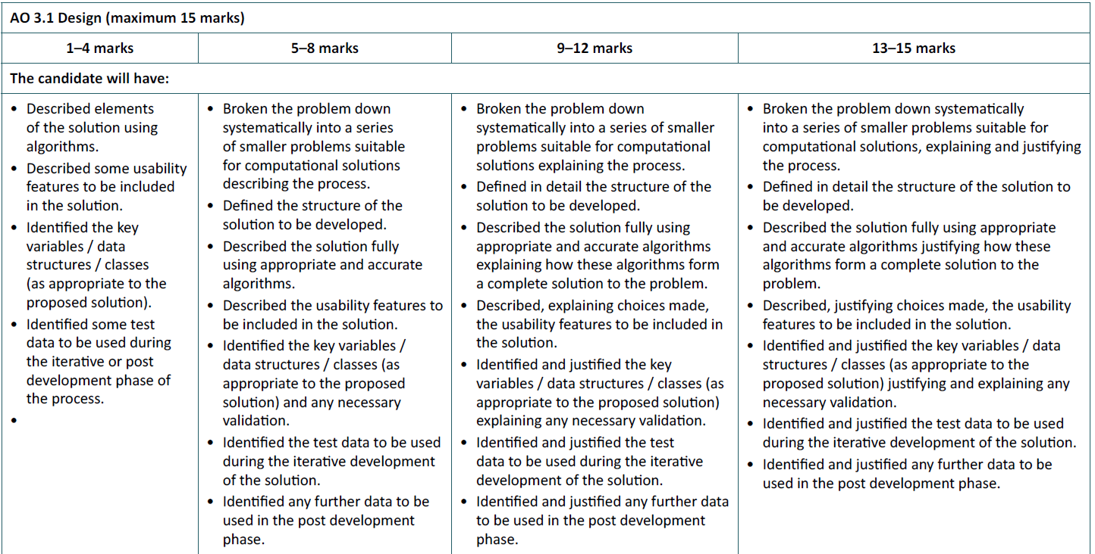
Design

Slide 33
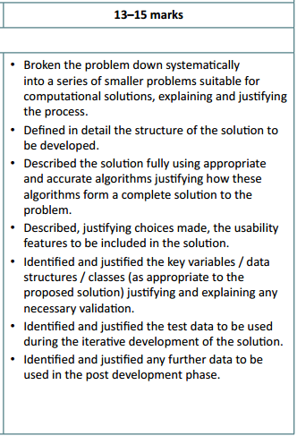
Design
Candidates should be using a suitable design methodology for their chosen project + language. For instance, use of class diagrams for OOP, or Top Down Design for Procedural.
Each smaller problem should be justified as to why this is a suitable “chunk” and how it fits in to the grand scheme
Flow Charts, Data Flow, Pseudocode etc. should be used appropriately to then design the program
There is no specified design methodology
Pseudocode is inherently required
The emphasis is that a 3rd party should be able to implement the solution directly from the designs
Suitable data structure design should be used as well
Test data for the initial designs should be specified on a ‘module by module’ approach, as well as test data that will be used to ensure all of the Success Criteria are met
Awarding of marks for Design and Test plans may be awarded at a later date if the candidate decides that initial designs/tests may need modification/adaptation

Slide 34
Iterative development of coded solution
Show how the solution was created
Write a section of code
Show it
Test it (next section)
Comment on result (show change/correction and further test(s) if needed)
Evidence of prototypes (where used)
Comment code
Appropriate identifiers
Validation

Slide 35
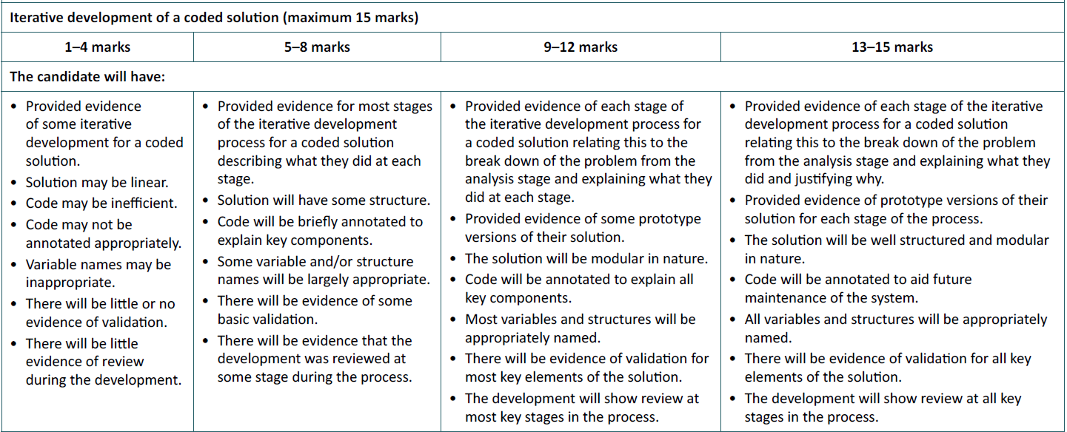
Iterative development of coded solution

Slide 36
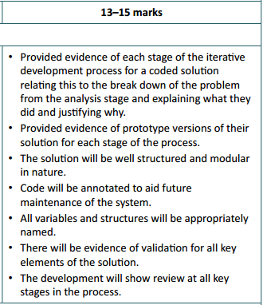
Development
Avoid ‘death by screen shot’
Prints of Code blocks/modules with descriptions are fine – no need for ‘line by line account’
Highlight unique features or ‘complex coding’ etc. – i.e. Showcase the complexity
Develop in blocks/chunks as defined in the design
Test as you go – no need to wait until the end
Agile/Iterative/RAD styled development
Good annotation in code will reduce quantity of writing
‘Lean and Mean’ – keep the development as concise as possible
Ensure good naming conventions are used (should be included in designs). Candidates that use Form_1 etc., are not showing good maintainability of code.
Highlight the validation – emphasise robust coding
Check Points/Milestones after each module – review back to Success Criteria
Signed off development by Stakeholders for each iteration

Slide 37
Testing to inform development
Do not separate from previous section
Evidence of testing at each stage
Show any corrections and explain them

Slide 38
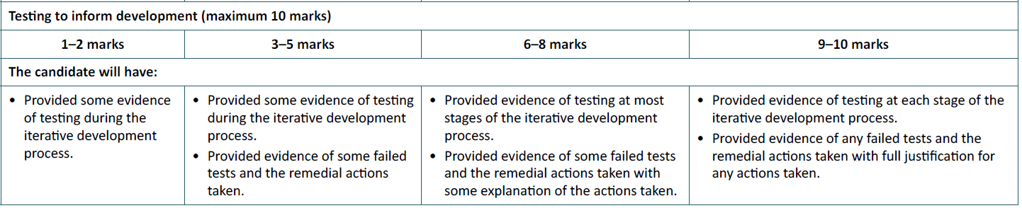
Testing to inform development

Slide 39
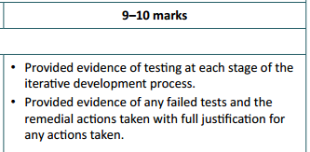
Testing (Development)
Test at the end of each ‘module’
No need to screenshot every test – especially if repetitious
Highlight failed tests
Must be enough to convince moderator of working solution
It is fine to re-design etc. at this point and you can still refer to this redesign to reflect a full working solution when awarding marks in the Design Section
Any modification of test plans may also be used in the same way
Must show re-development and testing where appropriate to gain full marks
Ensure all white box testing (functionality) is completed at this stage.
Testing for Use Acceptance (black box) is contained as part of evaluation
This may form part of the testing they do as they develop, but is awarded in AO3.3, rather than AO3.2

Slide 40
Testing to inform evaluation
Completed test plans
Evidence of results
Test:
Functionality
Robustness
Usability

Slide 41
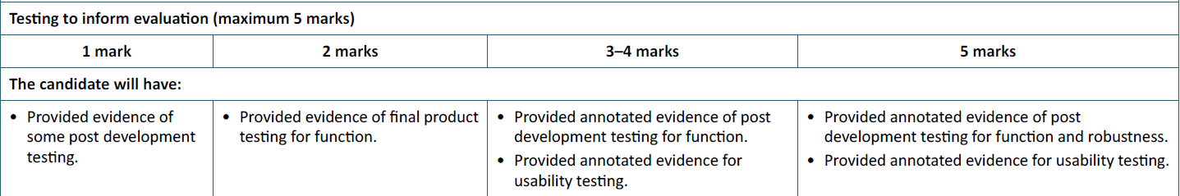
Testing to inform evaluation

Slide 42
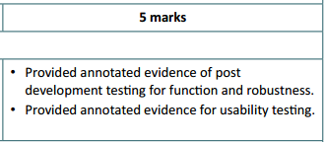
Evaluation (Testing)
Black Box testing / User Acceptance Testing
Involve all Stakeholders
Identify issues raised from testing
Again, it is fine to discuss solutions to any ‘failures’ and repeat the design/implementation phases to solve issues
Must prove that the system meets all of the success criteria
May reference successes from earlier in project – no need to repeat
Reference clearly back to evidence through page numbers (and make sure they are correct!)

Slide 43
Evaluation of solution
Compare to success criteria
With evidence (or cross reference to where the evidence can be found)
If not/partially met, comment on how it could be addressed in the future
Discuss success of usability features
If not/partially, how can it be addressed in the future
Discuss potential maintenance issues that may occur
Discuss limitations with the solution
Describe how the program could be improved to deal with limitations

Slide 44
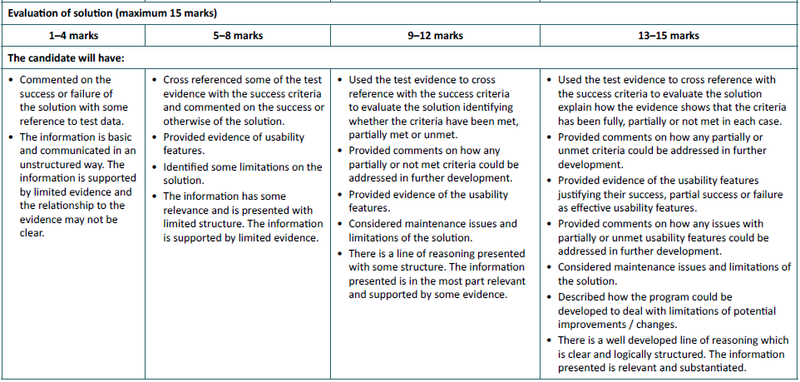
Evaluation of solution

Slide 45
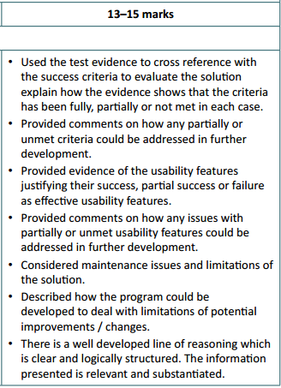
Evaluation
Summary of final Success Criteria
Again – cross reference to any earlier evidence to save repetition
Identify any potential limitations arising from the solution
A) They may go back and edit/customise if time allows
B) Critique if these are in fact future development problems
Evidence that GUIs and Features are suitable and effective
Discuss development of features that may be functional to meet success criteria, but could also be improved
Explain impact of this development on final product
Discuss how the system will need to be maintained
Refer to code maintenance
Evolving requirements of Stakeholders
Refer to evidence, development, research etc. to support all of these justifications clearly.
Ensure that sources are robust and wide-ranging

Slide 46
General Guidance
Drive to reduce the volume of paperwork submitted
Link back to evidence where needed – cut out repetition
Focus on coding elements and demonstration of depth
Reward design/testing plans where they occur and holistically for the mark band
(i.e. initial non-working designs that are then corrected will be rewarded)
Removal of user guide – no requirement to have to write one any more
Interaction with Stakeholders is fine – but not cumbersome! See centre moderator report
It may be appropriate to provide video evidence of working solution if write-up does not do it justice ensure timings are discussed and justified
Notes:
Link back to evidence – here you can inform attendees that evidence could be linked back for all parts of the marking criteria instead of candidates repeating evidence within their report

Slide 47
Submission
Mark sheet with comments
Additional sheets explaining and justifying marks with cross referencing to pages always helps
Electronic submission preferable (interchange, or CD/USB posted)
Report in one document (preferred pdf)
Additional sources e.g. videos for testing can be submitted if clearly referenced in report

Slide 48
Reviewing Candidate Work
Exemplar Candidate’s Work - Set B available on the USB
High
Med
Low

Slide 49
Marking Sample Set B - High
Use the PDF of the High Sample work you have been given
Use the previous slides to scan through the project and allocate a mark in each band
Total the marks up to give an overall score
Guidance
Look for the key evidence first – skim read and get a feel
This is a High graded piece of work! Therefore we are looking at top mark band for all sections
Notes:
Inform delegates that the sample project work is from June 2017 series
All marks were agreed in moderation
Marks may still have some variance with a “true” mark
Always try to pick the best parts out to then use to support teaching how to do each section

Slide 50
Marking Sample Set B - High
General Advice
Extremely extensive piece of work
Moderator notes this throughout – candidate does go above and beyond what is needed to reach top mark band marks
Pick out examples of best practise for students, rather than give them with entire projects
Avoids ‘copy and paste’
Gives a better range of ideas on how to meet criteria which may suit some candidates over others
Despite volume – moderator does query quality in some sections – always get students to focus on quality > quantity
Not always scoring top marks/mark band

Slide 51
Now skim read your sample student file
Use the previous slides to scan through the project and allocate a mark in each band
Total the marks up to give an overall score
Guidance
Look for the key evidence first – skim read and get a feel
Notes:
Inform delegates that the sample project work is from June 2017 series
All marks were agreed in moderation
Marks may still have some variance with a “true” mark
Always try to pick the best parts out to then use to support teaching how to do each section

Slide 52
Marking Sample Set B - High
TIME TO LOOK THROUGH THE WORK and your student example work

Slide 53
Marking Sample Set B - High
Analysis (Summary of commentary)
Good research
Detail throughout
Good research to help support and inform
Essential features clear and justified
Discussion of Computational Thinking is strong
Clear limitations identified
Limitations are slightly generic, but does not hold this section back
Add your comments to the teacher comment marking sheet

Slide 54
Marking Sample Set B - High
Design (Summary of commentary)
Scope of project is recognised as being beyond A Level
Designs are decomposed well
Good descriptions
Designs adapted and explanations why
Pre-run testing with trace tables
File structures identified
Usability and UI discussed
Each module contains validation and variables
Example of how a Data Dictionary is not a necessity
Description of testing is slightly weaker

Slide 55
Marking Sample Set B - High
Development (Summary of commentary)
Very well documented iterations
Code/Screen shots document story
Iterative testing use to inform development
Periodic reviews
Very thorough – but could be more succinct
Excessive code explanation for some parts add to bulk
Good code maintenance

Slide 56
Marking Sample Set B - High
Testing to inform Development (Summary of commentary)
Clear testing evidence for all iterations
Evidence of before and after screenshots to show errors had be corrected

Slide 57
Marking Sample Set B - High
Testing to inform Evaluation (Summary of commentary)
Alpha and Beta testing shown
Points raised are commented on in depth
Clearly show functionality and usability assessed
Stakeholder views sought

Slide 58
Marking Sample Set B - High
Evaluation of Solution (Summary of commentary)
Open and honest
Maintenance discussed
Limitations addressed
Review of System Requirements
Improvements identified and potential implementations
Some replication of system tweaks here (not needed)
Cross-referencing not always thorough

Slide 59
Marking Sample Set B - High
General Comments
Overall a very solid piece of work
Total mark was 66/70
Definitely excessive in length – as reflective in the examiner’s commentary
Contains very good examples of ‘how to’ in each section
Extract the best bits and use as demonstration to students, rather than give them the lot!
Add up your scores! – do we all agree?

Slide 60

Marking Sample Set B – Mid Do Sample B Mid & Low after CPD Session
Use the PDF of the High Sample work you have been given
Use the previous slides to scan through the project and allocate a mark in each band
Total the marks up to give an overall score
Guidance
Look for the key evidence first – skim read and get a feel
This is a mid graded piece of work!
Having seen the high, compare where this piece, and the high piece differ
Notes:
Inform delegates that the sample project work is from June 2017 series
All marks were agreed in moderation
Marks may still have some variance with a “true” mark
Always try to pick the best parts out to then use to support teaching how to do each section

Slide 61
General Advice
Solid piece of work, but some limitations
Pick out examples of best practise
Examiner does query quality in some sections get a feel from the work where these may be
Not always scoring top marks/mark band

Slide 62
Marking Sample Set B – Mid
TIME TO LOOK THROUGH THE WORK

Slide 63
Marking Sample Set B - Mid
Analysis (Summary of commentary)
Good research
Detail throughout
Essential features clear and justified
Discussion of Computational Thinking is not strong
Clear limitations identified

Slide 64
Marking Sample Set B - Mid
Design (Summary of commentary)
Identification of modularisation/breaking down
System Objectives clarify requirements
Good decomposition with suitable tools
Explanation of algorithms could be developed
Interfaces described, but could develop usability features
Security and validation discussed
Normalisation when using databases
Solid testing tables

Slide 65
Marking Sample Set B - Mid
Development (Summary of commentary)
Potentially slightly lenient
Project not fully complete
Evidence of working code
Needs to be linked to GUI more clearly
Thorough documentation
Some screenshots illegible
Good code structure and maintenance features
Important to remind candidates to ensure all screenshots are clear to support the evidence of a complete/working solution!

Slide 66
Marking Sample Set B - Mid
Testing to inform Development (Summary of commentary)
Definite room for improvement
Some evidence of tests to support development
Some test failures but not clear how/where these had been solved

Slide 67
Marking Sample Set B - Mid
Testing to inform Evaluation (Summary of commentary)
Must be clear differences between Development Testing and final solution testing
Testing is well analysed
Does not cover functionality testing
End User testing present
Robustness testing appears to be missing

Slide 68
Marking Sample Set B - Mid
Evaluation of Solution (Summary of commentary)
Solid reflection on analysis requirements
Not very well cross-referenced
Limitations not reviewed particularly well
Some maintenance discussion

Slide 69
Marking Sample Set B - Mid
General Comments
Overall a still a solid piece of work
Total mark was 55/70 (Grade A – just!)
Helps to show the difference between the bottom of Grade A band and a solid A*
Shows that even a project with some limitations can reach Grade A

Slide 70
Marking Sample Set B - Low
Use the PDF of the Low Sample work you have been given
Use the previous slides to scan through the project and allocate a mark in each band
Total the marks up to give an overall score
Guidance
Look for the key evidence first – skim read and get a feel
This is a low graded piece of work!
Having seen the high/mid, compare where this piece, and the high piece differ
Notes:
Inform delegates that the sample project work is from June 2017 series
All marks were agreed in moderation
Marks may still have some variance with a “true” mark
Always try to pick the best parts out to then use to support teaching how to do each section

Slide 71
Marking Sample Set B - Low
General Advice
Generally limited piece of work, but some strengths
Pick out examples of best practise
Generally low to middle mark band
Still some good bits of evidence within
Another good example of a diverse project

Slide 72
Marking Sample Set B - Low
TIME TO LOOK THROUGH THE WORK

Slide 73
Marking Sample Set B - Low
Analysis (Summary of commentary)
Brief analysis
Computational Approach is short, but related to project
Stakeholder descriptions could be more detailed
Very limited investigation into current solutions or ideas
Hardware and Software well discussed
Some limitations are well explained
Success Criteria need further justification
Not all criteria measurable

Slide 74
Marking Sample Set B - Low
Design (Summary of commentary)
Structure diagram not clear
Following diagrams show decomposition clearly
Validation discussed
Subroutines and pseudocode well presented
Lack of test strategy/planning

Slide 75
Marking Sample Set B - Low
Development (Summary of commentary)
Note that basic HTML/CSS template does not add to depth of solution – depth not at A Level standard
Some simple JavaScript functions shown
Testing is evidenced thoroughly
Slightly repetitious on testing
Evidence on video synchronisation is missing
Project cannot therefore be viewed as complete
Not a substantial solution

Slide 76
Marking Sample Set B - Low
Testing to inform Development (Summary of commentary)
Clear documentation of errors and remedies
Wide range of tests

Slide 77
Marking Sample Set B - Low
Testing to inform Evaluation (Summary of commentary)
Very little evidence of attempt in this section
Some testing of log-in pages

Slide 78
Marking Sample Set B - Low
Evaluation of Solution (Summary of commentary)
Some basic evaluations
Some requirements addressed
Not cross-referenced to test proof
Identification of limitations not present – despite opportunity to discuss earlier difficulties

Slide 79
Marking Sample Set B - Mid
General Comments
A project that clearly has limitations
Total mark was 28/70
Mid Grade E
Helps to show the difference between the Grade A/A* work seen and the Grade E
A good project idea that was not fully implemented
Could still have scored higher with review of limitations and evidencing of testing

